Slide 1
REPORT
Bio-ink
Laser Assistant Bio-printing
Pyroelectricity

Slide 2
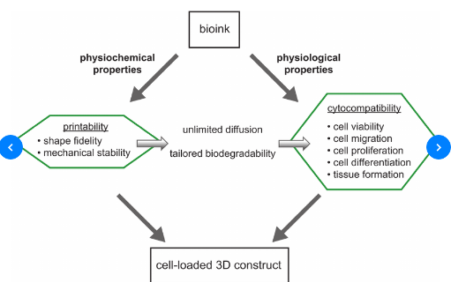
Bio-Ink
Bioinks are substances made of living cells that can be used for 3D printing of complex tissue models. Bioinks are materials that mimic an extracellular matrix environment to support the adhesion, proliferation, and differentiation of living cells.
Differences from traditional 3D printing materials
Printed at a much lower temperature (37 °C or below)
Mild cross-linking conditions
Natural derivation
Bioactive
Cell manipulatable

Slide 3
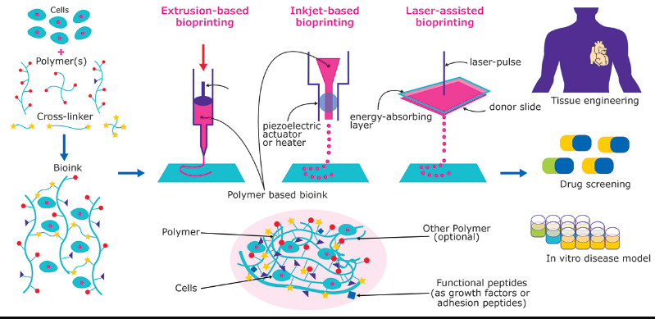
Bio-Ink
Important considerations in printability include:
Uniformity in filament diameter
Angles at the interaction of filaments
"Bleeding" of filaments together at intersects
Maintenance of shape fidelity after printing but before cross-linking
Printing pressure and nozzle diameter

Slide 4
Bio-Ink
Alginate-based
Alginate is a naturally derived biopolymer from the cell wall of brown algae that has been widely used as a biomaterial. Alginates are particularly suitable for bioprinting due to their mild cross-linking conditions via incorporation of divalent ions such as calcium. These materials have been adopted as bioinks through increasing their viscosity.[7] Additionally, these alginate-based bioinks can be blended with other materials such as nanocellulose for application in tissues such as cartilage

Slide 5
Bio-Ink
Gelatin-based
has been widely utilized as a biomaterial for engineered tissues. The formation of gelatin scaffolds is dictated by the physical chain entanglements of the material which forms a gel at low temperatures. However, at physiological temperatures, the viscosity of gelatin drops significantly. Methacrylation of gelatin is a common approach for the fabrication of gelatin scaffolds that can be printed and maintain shape fidelity at physiological temperature.^{[9]}

Slide 6
Bio-Ink
Decellularized ECM-based
Decellularized extracellular matrix based bioinks can be derived from nearly any mammalian tissue. However, often organs such as heart, muscle, cartilage, bone, and fat are decellularized, lyophilized, and pulverized, to created a soluble matrix that can then be formed into gels.[These bioinks possess several advantages over other materials due to their derivation from mature tissue. These materials consist of a complex mixture of ECM structural and decorating proteins specific to their tissue origin. Therefore, dECM-derived bioinks are particularly tailored to provide tissue-specific cues to cells. Often these bioinks are cross-linked through thermal gelation or chemical cross-linking such as through the use of riboflavin.[
]

Slide 7
Bio-Ink
Pluronics edit
Pluronics have been utilized in printing application due to their unique gelation properties.^{[12]} Below physiological temperatures, the pluronics exhibit low viscosity. However, at physiological temperatures, the pluronics form a gel. However, the formed gel is dominated by physical interactions. A more permanent pluronic-based network can be formed through the modification of the pluronic chain with acrylate groups that may be chemically cross-linked.^{[13]}
]

Slide 8
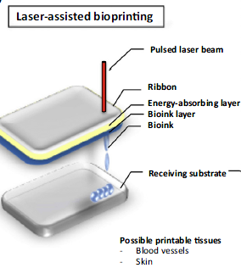
Laser Assistant Bio-printing
Laser-assisted bioprinters use pulsed laser beams focused on an energy-absorbing substrate to generate pressure that propels cell-containing material to deposit onto a receiving substrate
Advantage Can be used with viscous materialsHighly accurate
Disadvantage: Heat generated by laser can impact cells

Slide 9
Pyroelectricity
Pyroelectricity is the property presented by certain materials that exhibit an electric
polarization P when a temperature variation T is applied uniformly:
P = γ ×T (1)
where γ is the pyroelectric coefficient at constant stress. Pyroelectric crystals actually have
a spontaneous polarization, but the pyroelectric effect can only be observed during
a temperature change.

Slide 10
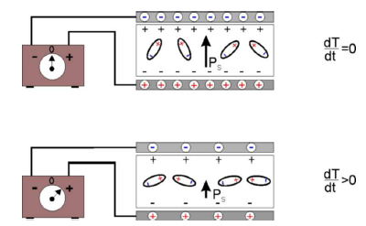
Pyroelectricity
If a pyroelectric crystal with an intrinsic dipole moment (top) is fashioned into a
circuit with electrodes attached on each surface (FIG. 1), an increase in temperature T
prompts the spontaneous polarization PS to decrease as the dipole moments, on average,
diminish in magnitude. The horizontal tilting of the dipoles, (pictured at bottom of FIG. 1),
signifies the effect. A current flows to compensate for the change in bound charge that
accumulates on the crystal edges.

Slide 11
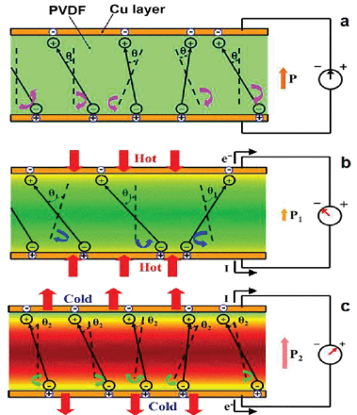
Pyroelectricity
Another definition of pyroelectricity is ability to generation of induced charges on the crystal
surface when they are heated or cooled. It is explained as a migration of positive and negative
charges (and therefore establishment of electric polarization) to opposite ends of a crystal's
polar axis as a result of change in temperature. This can be expressed as follows:
Q = γ ×ST

Slide 12
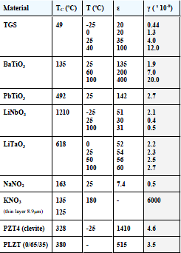
Pyroelectricity
Figure of merit for various pyroelectric materials.
TC (oC) - Curie temperature; T (oC) - temperature in °C at which measurements
were made; ε - dielectric permittivity; γ - pyroelectric coefficient in C/cm2K .
Applications
Movement detector
Pollution monitoring and gas analysis
Fire alarms
Pyroelectric thermal imaging

